Slide 1
7
C Pointers

Slide 2
Addresses are given to us to conceal our whereabouts.
Saki (H. H. Munro)
By indirection find direction out.
William Shakespeare
Many things, having full reference To one consent, may work contrariously.
William Shakespeare
You will find it a very good practice always to verify your references, sir!
Dr. Routh

Slide 3
OBJECTIVES
In this chapter you will learn:
Pointers and pointer operators.
To use pointers to pass arguments to functions by reference.
The close relationships among pointers, arrays and strings.
To use pointers to functions.
To define and use arrays of strings.

Slide 4
7.2 Pointer Variable Definitions and Initialization
Pointers are variables that contain memory addresses as their values.
A variable name directly references a value.
A pointer indirectly references a value. Referencing a value through a pointer is called indirection.
A pointer variable must be declared before it can be used.

Slide 5
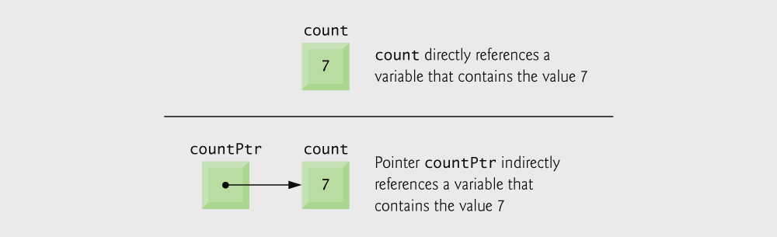
Fig. 7.1 | Directly and indirectly referencing a variable.

Slide 6
7.2 Pointer Variable Definitions and Initialization
Pointer definitions
* used with pointer variables
int *myPtr;
Defines a pointer to an int (pointer of type int *)
Multiple pointers require using a * before each variable definition
int *myPtr1, *myPtr2;

Slide 7
7.2 Pointer Variable Definitions and Initialization
Consider the statements:
#include <stdio.h>
int main ( )
{
int *aptr ; /* Declare a pointer to an int */
float *bptr ; /* Declare a pointer to a float */
int a ; /* Declare an int variable */
float b ; /* Declare a float variable */

Slide 8
Common Programming Error 7.1
Each pointer must be declared with the * prefixed to the name; e.g., if you wish to declare xPtr and yPtr as int pointers, use int *xPtr, *yPtr;.
int *xPtr, *yPtr
int *xPtr, yPtr
(1) Two pointers are declared
(2) Integer yPtr and pointer xPtr are declared

Slide 9
Good Programming Practice 7.1
Include the letters ptr in pointer variable names to make it clear that these variables are pointers and thus need to be handled appropriately.
int *myPtr ;
float *aPtr ;
char *kPtr;

Slide 10
Error-Prevention Tip 7.1
int y = 5;
int *yPtr=&y;
Initialize pointers to prevent unexpected results.

Slide 11

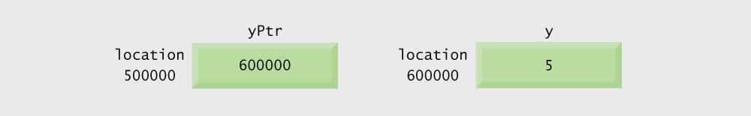
7.3 Pointer Operators
& (address operator) returns address of operand
int y = 5;
int *yPtr; // Declare a pointer to an int
yPtr = &y; /* yPtr gets address of y */
yPtr “points to” y
Fig. 7.2 | Graphical representation of a pointer pointing to an integer variable in memory.
Fig. 7.3 | Representation of y and yPtr in memory.

Slide 12
7.3 Pointer Operators
* (indirection/dereferencing operator)
Returns a synonym/alias of what its operand points to
*yptr returns y (because yptr points to y)
* can be used for assignment
int y = 5;
int *yPtr;
yPtr = &y;
*yptr = 7; /* changes y to 7 */

Slide 13
Error-Prevention Tip Do not forget to initialize pointers
int *yPtr;
*yPtr = 5;
yPtr has not been properly initialized or that has not been assigned to point to a specific location in memory is an error.
Therefore, 5 is stored to an unknown memory location.
This could cause a fatal execution-time error, or it could accidentally modify important data and allow the program to run to completion with incorrect results.

Slide 14
Outline
fig07_04.c
(1 of 2 )
If aPtr points to a, then &a and aPtr have the same value.
a and *aPtr have the same value
&*aPtr and *&aPtr have the same value

Slide 15
Fig. 7.5 | Operator precedence.

Slide 16
7.4 Calling Functions by Reference
Call by reference with pointer arguments
Pass address of argument using & operator
Allows you to change actual location in memory
Arrays are not passed with & because the array name is already a pointer
* operator
Used as alias/nickname for variable inside of function
void double( int *number )
{
*number = 2 * ( *number );
}
*number used as nickname for the variable passed

Slide 17
Outline
fig07_06.c
Call function by value

Slide 18
Outline
Function prototype takes a pointer (address) as an argument
fig07_07.c
An address is passed to function, which can be the value of a pointer variable
This function modifies the value of number itself.

Slide 19
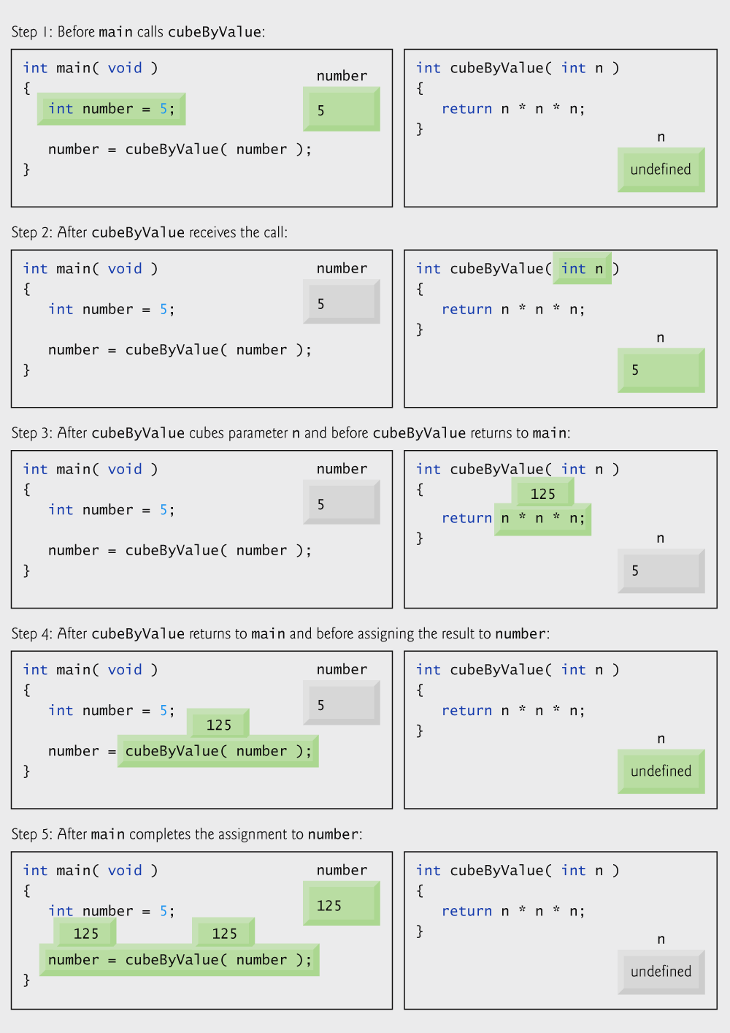
Fig. 7.8 | Analysis of a typical call-by-value.

Slide 20
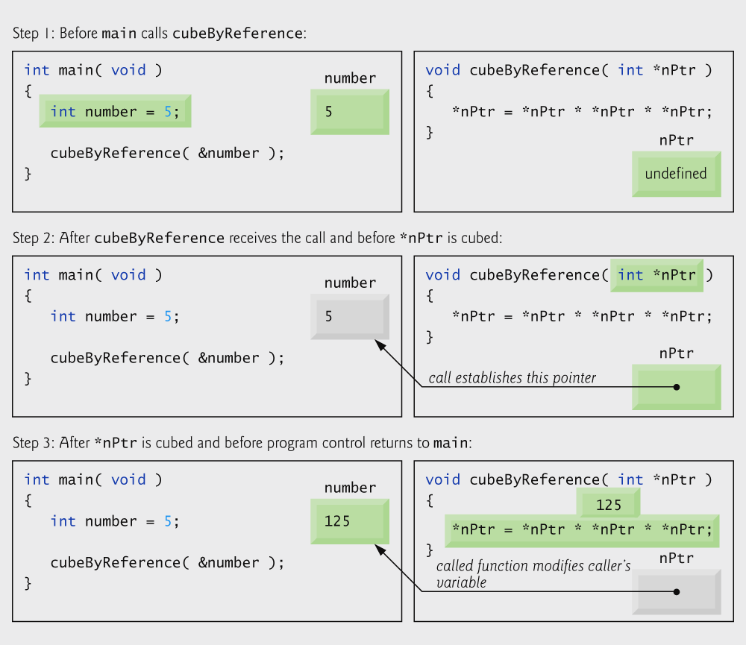
Fig. 7.9 | Analysis of a typical call-by-reference with a pointer argument.

Slide 21
int x = 1, y = 2, z[10];
int *ip; // ip is a pointer to an int, so it can point to x, y, or an element of z
ip = &x; // ip now points at the location where x is stored
y = *ip; // set y equal to the value pointed to by ip, or y = x
*ip = 0; // now change the value that ip points to to 0, so now x = 0
// but notice that y is unchanged
ip = &z[0]; // now ip points at the first location in the array z
*ip = *ip + 1; // the value that ip points to (z[0]) is incremented
int x, *y, z, *q;
x = 3;
y = &x; // y points to x
printf("%d\n", x); // outputs 3
printf("%d\n", y); // outputs x’s address, will seem like a random number
printf("%d\n", *y); // outputs what y points to, or x (3)
printf("%d\n", *y+1); // outputs 4 (print out what y points to + 1)
printf("%d\n", *(y+1)); // this outputs the item after x in memory – what is it?
z = *(&x); // z equals 3 (what &x points to, which is x)
q = &*y; // q points to 3 – note *& and &* cancel out
Notes:
What happens when you try to dereference p+1? That is, int *p = &x; followed by *(p+1) ???
It depends on what is stored next in memory. The location (p+1) is not 1 byte + the location of p, but instead byte p + n where n is the size of the datum that p points to (4 bytes for an int or a float, 8 bytes for a double or long, 1 byte for char, 2 bytes for a short). Lets consider the following code:
int x=1, y=10, z=100;
int *p = &x; // p now points at x
printf(“%d %d %d\n”, *p, *(p+1), *(p+2));
This will probably about 1 10 100. Why? The compiler will usually place local variables in contiguous blocks of memory. So *p points at x but *(p+1) will probably point at y (but not definitely) and *(p+2) will point at z. So notice that *(p+2) is perfectly legal syntactically and may execute without error. If you are wrong with this assumption, or careless, then you will get a run-time error because you have tried to dereference an area of memory that is either not your own, or not a variable (it is possible that you are dereferencing code, which is not legal).

Slide 22
int x[4] = {12, 20, 39, 43}, *y;
y = &x[0]; // y points to the beginning of the array
printf("%d\n", x[0]); // outputs 12
printf("%d\n", *y); // also outputs 12
printf("%d\n", *y+1); // outputs 13 (12 + 1)
printf("%d\n", (*y)+1); // also outputs 13
printf("%d\n", *(y+1)); // outputs x[1] or 20
y+=2; // y now points to x[2]
printf("%d\n", *y); // prints out 39
*y = 38; // changes x[2] to 38
printf("%d\n", *y-1); // prints out x[2] - 1 or 37
*y++; // sets y to point at the next array element
printf("%d\n", *y); // outputs x[3] (43)
(*y)++; // sets what y points to to be 1 greater
printf("%d\n", *y); // outputs the new value of x[3] (44)

Slide 23
7.5 Using the const Qualifier with Pointers
const qualifier
Variable cannot be changed
Use const if function does not need to change a variable
Attempting to change a const variable produces an error
const pointers
Point to a constant memory location must be initialized when defined
int x;
int *const myPtr = &x; //constant pointer to an int
//pointer value can not be changed. x value can be changed
const int *myPtr = &x; //modifiable pointer to a const int
//pointer value can be changed. x value can not be changed
const int *const Ptr = &x; //const pointer to a const int
//pointer and x values can not be changed.

Slide 24
Outline
Both sPtr and *sPtr are modifiable
fig07_10.c
(1 of 2 )

Slide 25
Outline
fig07_10.c
(2 of 2 )
Both sPtr and *sPtr are modified by the convertToUppercase function

Slide 26
Outline
Pointer variable sPtr is modifiable, but the data to which it points, *sPtr, is not
fig07_11.c
(1 of 2 )

Slide 27
Outline
fig07_11.c
(2 of 2 )
sPtr is modified by function printCharacters
Starting conditions of the ‘for loop structure’ is defined in the previous codes.

Slide 28
Outline
Pointer variable xPtr is modifiable, but the data to which it points, *xPtr, is not
fig07_12.c
*xPtr has the const qualifier, so attempting to modify its value causes an error

Slide 29
Outline
fig07_13.c
Pointer ptr is not modifiable, but the data to which it points, *ptr, can be changed

Slide 30
Outline
fig07_14.c
Neither pointer sPtr nor the data to which it points, *sPtr, is modifiable

Slide 31
7.6 Bubble Sort Using Call-by-Reference
Implement bubble sort using pointers
Swap two elements
swap function must receive address (using &) of array elements
Array elements have call-by-value default
Using pointers and the * operator, swap can switch array elements
Psuedocode
Initialize array
print data in original order
Call function bubble sort
print sorted array
Define bubble sort

Slide 32
Outline
fig07_15.c
(1 of 3 )

Slide 33
Outline
fig07_15.c
(2 of 3 )
Prototype definition: swap function is only defined in bubblesort function

Slide 34
Outline
fig07_15.c
(3 of 3 )
Function swap changes the values of the ints that the two pointers point to

Slide 35
Software Engineering Observation 7.4
When passing an array to a function, also pass the size of the array. This helps make the function reusable in many programs.

Slide 36
7.7 sizeof Operator
sizeof
Returns size of operand in bytes
For arrays: size of 1 element * number of elements
if sizeof(int ) equals 4 bytes, then
int myArray[ 10 ];
printf( "%d", sizeof( myArray ) );
will print 40
sizeof can be used with
Variable names
Type name
Constant values

Slide 37
Performance Tip 7.2
sizeof is a compile-time operator, so it does not incur any execution-time overhead.

Slide 38
Portability Tip 7.2
The number of bytes used to store a particular data type may vary between systems.
When writing programs that depend on data type sizes and that will run on several computer systems, use sizeof to determine the number of bytes used to store the data types.

Slide 39
Outline
fig07_17.c
(1 of 2 )

Slide 40
Outline
fig07_17.c
(2 of 2 )

Slide 41
7.8 Pointer Expressions and Pointer Arithmetic
Arithmetic operations can be performed on pointers
Increment/decrement pointer (++ or --)
Add an integer to a pointer( + or += , - or -=)
Pointers may be subtracted from each other
Operations meaningless unless performed on an array

Slide 42
7.8 Pointer Expressions and Pointer Arithmetic
5 element int array on machine with 4 byte ints
vPtr points to first element v[ 0 ]
at location 3000 (vPtr = 3000)
vPtr += 2; sets vPtr to 3008
vPtr points to v[ 2 ] (incremented by 2), but the machine has 4 byte ints, so it points to address 3008

Slide 43
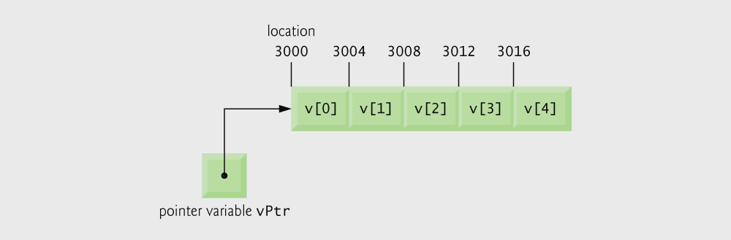
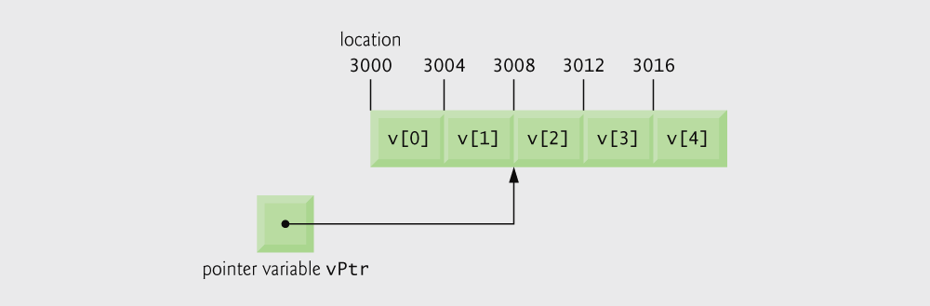
Fig. 7.18 | Array v and a pointer variable vPtr that points to v.
vPtr += 2; sets vPtr to 3008
Fig. 7.19 | The pointer vPtr after pointer arithmetic.

Slide 44
Portability Tip 7.3
Most computers today have 2-byte or 4-byte integers. Some of the newer machines use 8-byte integers. Because the results of pointer arithmetic depend on the size of the objects a pointer points to, pointer arithmetic is machine dependent.

Slide 45
7.8 Pointer Expressions and Pointer Arithmetic
Subtracting pointers
Returns number of elements from one to the other. If
vPtr2 = v[ 2 ];
vPtr = v[ 0 ];
vPtr2 - vPtr would produce 2
Pointer comparison ( <, == , > )
See which pointer points to the higher numbered array element
Also, see if a pointer points to 0

Slide 46
7.8 Pointer Expressions and Pointer Arithmetic
Pointers of the same type can be assigned to each other

Slide 47
7.9 Relationship Between Pointers and Arrays
Arrays and pointers closely related
Array name like a constant pointer
Pointers can do array subscripting operations
Define an array b[ 5 ] and a pointer bPtr
To set them equal to one another use:
bPtr = b;
The array name (b) is actually the address of first element of the array b[5]
bPtr = &b[0]
Explicitly assigns bPtr to address of first element of b

Slide 48
7.9 Relationship Between Pointers and Arrays
Element b[ 3 ]
Can be accessed by *( bPtr + 3 )
Where 3 is called the offset. Called pointer/offset notation
Can be accessed by bptr[ 3 ]
Called pointer/subscript notation
bPtr[ 3 ] same as b[ 3 ]
Can be accessed by performing pointer arithmetic on the array itself
*( b + 3 )

Slide 49
Outline
fig07_20.c
(1 of 3 )
Array subscript notation
Array/offset notation

Slide 50
Outline
Pointer subscript notation
fig07_20.c
(2 of 3 )
Pointer offset notation

Slide 51
Outline
fig07_20.c
(3 of 3 )

Slide 52
Outline
fig07_21.c
(1 of 2 )

Slide 53
Outline
fig07_21.c
(2 of 2 )
perform same action

Slide 54
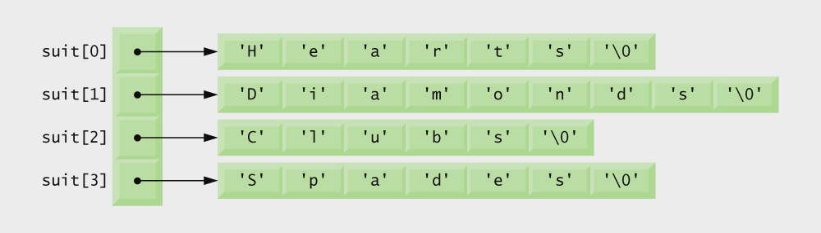
7.10 Arrays of Pointers
Arrays can contain pointers
For example: an array of strings
char *suit[ 4 ] = { "Hearts", "Diamonds", "Clubs", "Spades" };
Strings are pointers to the first character
Each element of suit is a pointer to a char
The strings are not actually stored in the array suit, only pointers to the strings are stored

Slide 55
Sample Code:
#include <stdio.h>
const int MAX = 4;
int main () {
char *names[] = {"Mert", "Fatma", "Ali", "Mehmet" };
int i = 0;
for ( i = 0; i < MAX; i++) {
printf( "Name= %s\n", names[i] ); // prints each name
}
for ( i = 0; i < MAX; i++) {
printf( "%p\n", names[i] ); // prints the adress of the first character of each name
}
return 0;
}
Output:
Name= Mert
Name= Fatma
Name= Ali
Name= Mehmet
0000000000404000
0000000000404005
000000000040400B
000000000040400F
+5
+6

Slide 56
7.12 Pointers to Functions
Pointer to function
Contains address of function
Similar to how array name is address of first element
Function name is starting address of code that defines function
Function pointers can be
Passed to functions
Stored in arrays
Assigned to other function pointers

Slide 57
7.12 Pointers to Functions
Example: bubblesort
Function bubble takes a function pointer
bubble calls this helper function
this determines ascending or descending sorting
The argument in bubblesort for the function pointer:
int ( *compare )( int a, int b )
tells bubblesort to expect a pointer to a function that takes two ints and returns an int
If the parentheses were left out:
int *compare( int a, int b )
Defines a function that receives two integers and returns a pointer to a int

Slide 58
Outline
fig07_26.c
(1 of 4 )
bubble function takes a function pointer as an argument

Slide 59
Outline
fig07_26.c
(2 of 4 )
depending on the user’s choice, the bubble function uses either the ascending or descending function to sort the array

Slide 60
Outline
fig07_26.c
(3 of 4 )
Note that what the program considers “out of order” is dependent on the function pointer that was passed to the bubble function

Slide 61
Outline
fig07_26.c
(4 of 4 )
Passing the bubble function ascending will point the program here
Passing the bubble function descending will point the program here

Slide 62
Outline

Slide 63
Outline
fig07_28.c
(1 of 3 )
Array of pointers to functions

Slide 64
Outline
Function called is dependent on user’s choice
fig07_28.c
(2 of 3 )

Slide 65
Outline
fig07_28.c
(3 of 3 )

